Slide 1
Lab 1 Programming Basic
CSC-113
Engr. Ramsha Mashood
COMPUTER PROGRAMMING

Slide 2
About Teacher:
Engr. Ramsha Mashood
Working as Junior Lecturer/ Lab Engineer.
Formerly worked as Senior Software Engineer in Gul Ahmed Textile Mills.
Passionate and Enthusiastic.
Email Addresses:
rmsiddiqui93@gmail.com
ramshamashood.bukc@bahria.edu.pk
Site link: https://sites.google.com/site/ramshamashood2018/labs/computer-programming-1-a-b?pageMoved=Labs

Slide 3
Policies:
Attendance
Students are expected to attend all Labs. If a student misses 3 sessions from lab or 10 hours in total without an acceptable reason, the student will be barred from the final lab exams.
Code of Conduct
The assignments and exams need to be done individually.
Project Deadlines
Copying of another student's work or code, even if changes are subsequently made, is inappropriate, and such work or code will not be accepted. However, in case of group assignments, copying of another group’s work or code, even if changes are subsequently made, is inappropriate, and such work or code will not be accepted.

Slide 4
Evaluation criteria (Tentative):
LAB EVALUATION
Evaluation Instruments (EI) | Marks
LAB WORK | 60
LAB PERFORMANCE +OPEN ENDED LAB LAB EXAM/VIVA VOCE LAB JOURNAL | 30 10 20
ASSIGNMENT (2 Assignments) | 10
PROJECT | 30
DEMONSTRATION MANAGEMENT | 20 10
Total: | 100

Slide 5
List of Equipment/Requirements:
Hardware Requirements:
A personal computer
Software Requirements:
Visual studio 2015
Concept of C#.

Slide 6
Introduction to VISUAL STUDIO IDE
The Visual Studio integrated development environment is a creative launching pad that you can use to edit, debug, and build code, and then publish an app. An integrated development environment (IDE) is a feature-rich program that can be used for many aspects of software development. Over and above the standard editor and debugger that most IDEs provide, Visual Studio includes compilers, code completion tools, graphical designers, and many more features to ease the software development process.

Slide 7
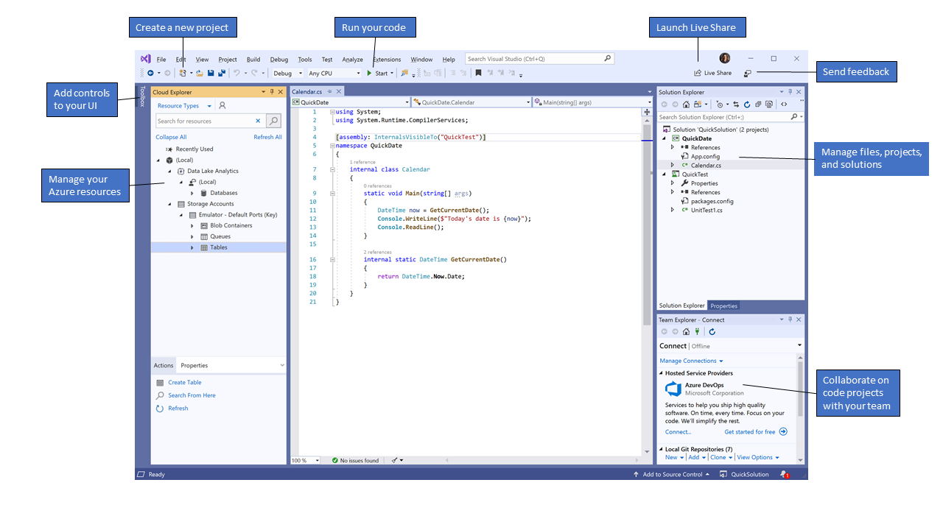
Ide view

Slide 8
Solution Explorer (top right) lets you view, navigate, and manage your code files. Solution Explorer can help organize your code by grouping the files into solutions and projects.
The editor window (center), where you'll likely spend a majority of your time, displays file contents. This is where you can edit code or design a user interface such as a window with buttons and text boxes.
Team Explorer (bottom right) lets you track work items and share code with others using version control technologies such as Git and Team Foundation Version Control (TFVC).

Slide 9

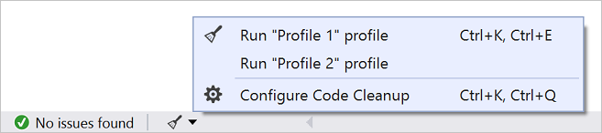
CODE PRODUCTIVITY FEATURES
QUICK ACTIONS
CODE CLEANUP

Slide 10
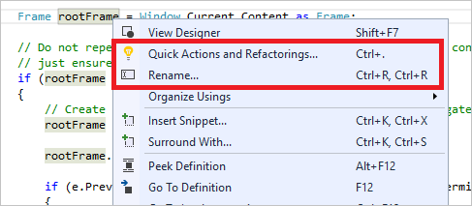
CODE PRODUCTIVITY FEATURES
Refactoring
Refactoring includes operations such as intelligent renaming of variables, extracting one or more lines of code into a new method, changing the order of method parameters, and more.

Slide 11
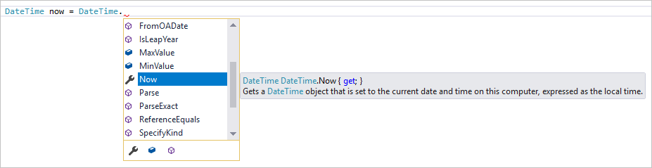
CODE PRODUCTIVITY FEATURES
IntelliSense

Slide 12
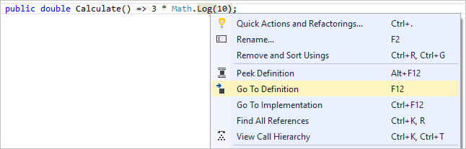
CODE PRODUCTIVITY FEATURES
Go to definition

Slide 13
Introduction
Use of computers
Solve problems
Perform calculations
Program
"A program is a precise sequence of steps to solve a particular problem.”
or
“A program is a sequence of steps written to run on a machine.”

Slide 14
What is C#?
C# is pronounced "C-Sharp".
It is an object-oriented programming language created by Microsoft that runs on the .NET Framework.
C# has roots from the C family, and the language is close to other popular languages like C++ and Java.
The first version was released in year 2002. The latest version, C# 8, was released in September 2019.

Slide 15
WHERE TO USE C#
Mobile applications
Desktop applications
Web applications
Web services
Web sites
Games
Database applications
And much, much more!

Slide 16
WHY WE USE C#
It is one of the most popular programming language in the world
It is easy to learn and simple to use
It has a huge community support
C# is an object oriented language which gives a clear structure to programs and allows code to be reused, lowering development costs.
As C# is close to C, C++ and Java, it makes it easy for programmers to switch to C# or vice versa

Slide 17
Working of a C# Program
void Main() must be present in all the programs
{ and } specify the beginning and the end of the program
Initial statements are for the declaration of variables
Statements that follow the declaration are the processing statements
All statements should end with a semicolon

Slide 18
syntax
using System;
namespace HelloWorld
{
class Program
{
static void Main(string[] args)
{ Console.WriteLine("Hello World!");
}
}
}

Slide 19
Cont…
To write:
Console.Write(“First Name");
Console.Write(“Last Name");
To write in single line:
Console.WriteLine(“First Name");

Slide 20
For reading from user
Console.readline();
static void Main(string[] args)
{
string myname;
Console.Write("write your name ");
myname = Console.ReadLine();
Console.WriteLine("my name is "+ myname);
}

Slide 21
EScape Sequences
Escape sequence | Character represented
\a | Alert (Beep, Bell) (added in C89)
\b | Backspace
\e | escape character
\f | Form feed Page Break
\n | Newline (Line Feed)
\r | Carriage Return
\t | Horizontal Tab
\v | Vertical Tab
\\ | Backslash
\' | Apostrophe or single quotation mark
\" | Double quotation mark
\? | Question mark (used to avoid trigraphs)

Slide 22
TASKS
Write step how to install visual studio
Show the output of all examples mention in the lab
Write a program to print your profile using c#.

Slide 23
Thanks You

